Slide 1
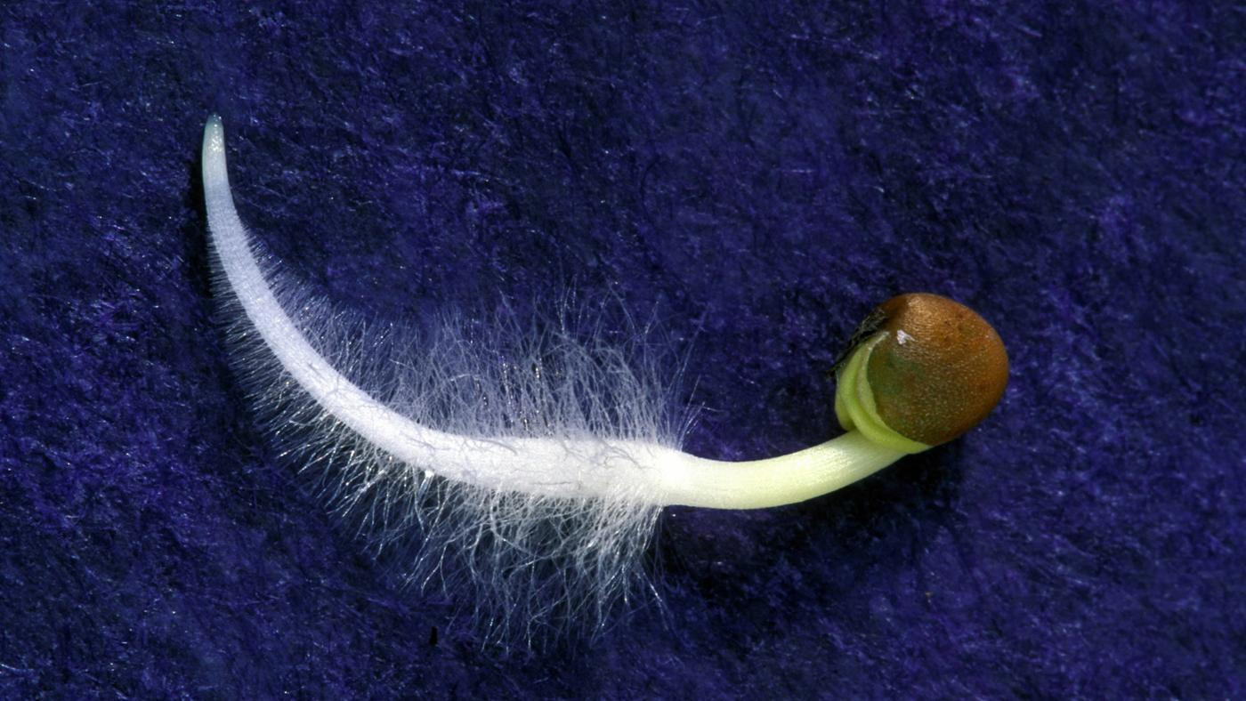
How do plants absorb water and minerals?
p.10-8

Slide 2
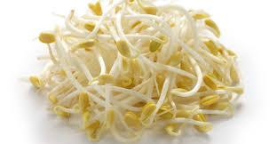
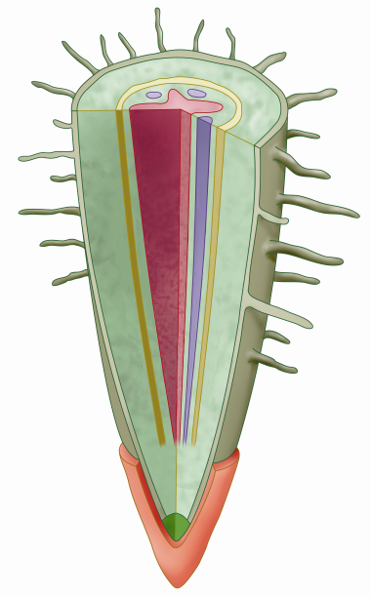
How do plants absorb water and minerals?
Terrestrial plants absorb water and minerals from the soil mostly by their roots.
1. Structure of the root
a protective tissue called the root cap at the tip of the root

Slide 3
How do plants absorb water and minerals?
1. Structure of the root
The outermost layer of the root is the epidermis, which protects the inner tissues from injury and infection.
made up of thin-walled cells
Many of the epidermal cells near the root tip develop extensions called root hairs that increase the surface area for absorbing water and minerals.

Slide 4
How do plants absorb water and minerals?
1. Structure of the root
The tissue beneath the epidermis is the cortex. The cortex cells store food and allow the passage of water and minerals across the root.
The vascular tissues, xylem and phloem are arranged in a vascular bundle at the centre of the root.
Xylem transports water and minerals.
Phloem transports food.

Slide 5
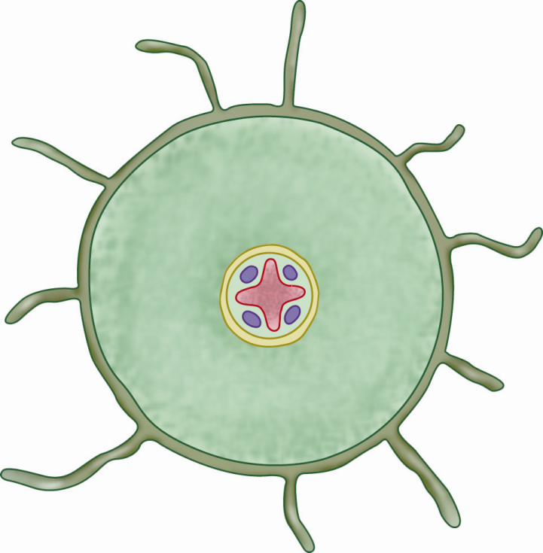
The structure of the root of a dicotyledonous plant
root hairs
epidermis
vascular bundles
xylem
phloem
cortex
phloem
root cap
xylem
Longitudinal section of a root
Transverse section of a root

Slide 6
The structure of the root of a dicotyledonous plant
epidermis
protects the inner tissues
often has many root hairs
cortex
stores food
allows the passage of water and minerals across the root
Notes:
6

Slide 7
The structure of the root of a dicotyledonous plant
phloem
transport food
xylem
transport water and minerals
root cap
protects the root tip
Notes:
7

Slide 8
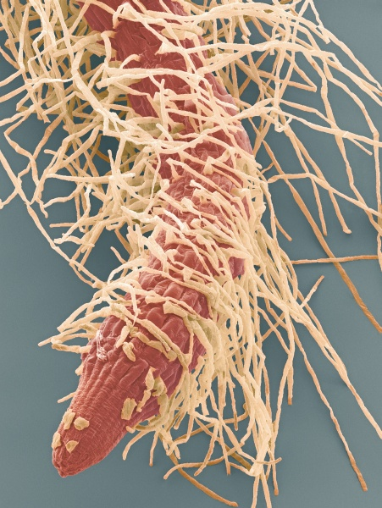
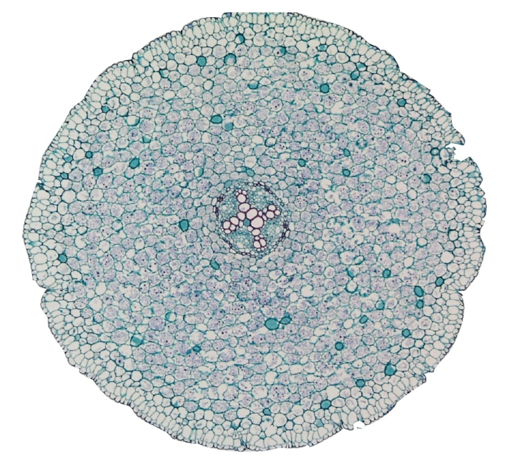
The structure of the root of a dicotyledonous plant
root hair
epidermis
phloem
xylem
root cap
cortex
Root tip of a seedling (x60)
Transverse section of a dicotyledonous root (x100)

Slide 9
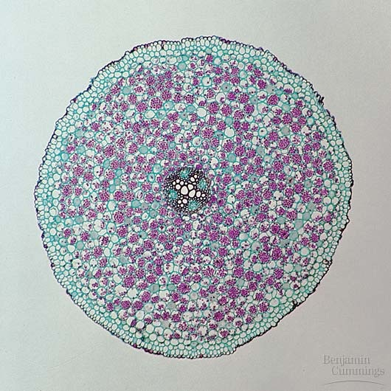
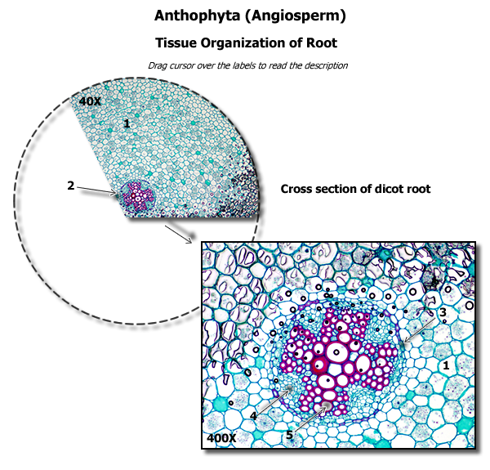

Slide 10
Adaptation of roots for the absorption of water and minerals
The root epidermis is not covered by cuticle.
consists of one layer of thin-walled cells
water and minerals can enter the roots more easily
The branching of roots and the numerous root hairs.
greatly increase the surface area for the absorption of water and minerals

Slide 11
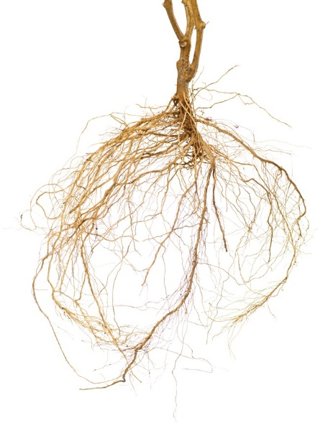
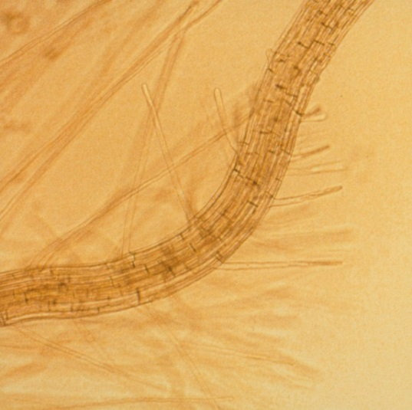
Adaptation of roots for the absorption of water and minerals
The root hairs are long and fine.
can penetrate the spaces between soil particles to absorb water and minerals
root hairs
Roots have numerous branches.
Photomicrograph showing the longitudinal section of a root (x150)
Notes:
11

Slide 12
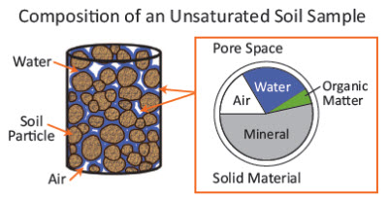
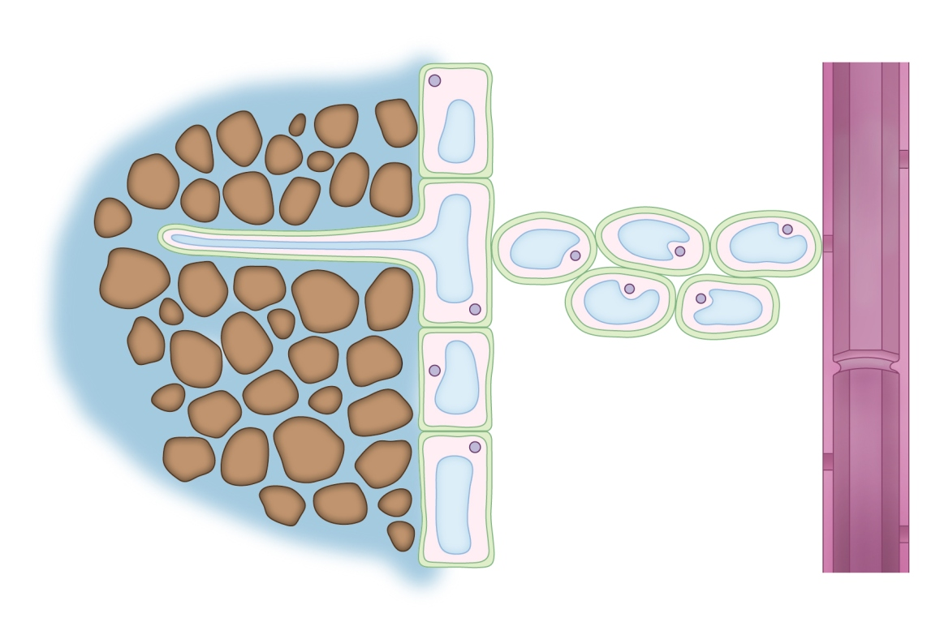
How do plants absorb water and minerals?
2. Absorption of water by roots
Soil water usually has a water potential higher than that of the cytoplasm and the cell sap of the root hair cells.
Water moves into the root hair by osmosis.
1 Water moves into the root hair by osmosis
Notes:
12

Slide 13
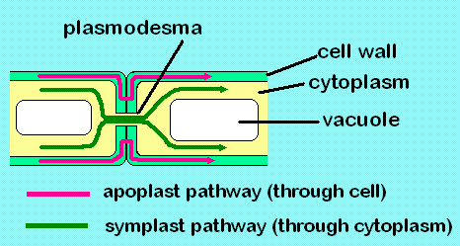
How do plants absorb water and minerals?
2. Absorption of water by roots
As water moves into the root hairs, the water potential of the cytoplasm and the cell sap increases.
Water then moves into the neighbouring cortex cells by osmosis.
Water moves across the cortex from cell to cell by osmosis until it reaches the xylem vessels.
2a Water moves across the cortex from cell to cell by osmosis
2b Water moves along the cell walls of the cortex cells

Slide 14
How do plants absorb water and minerals?
2. Absorption of water by roots
Some water may also move inwards along the cell walls, from cell to cell, without entering the cytoplasm or the vacuole.
Eventually, water is drawn up the xylem vessels by the transpiration pull.
3 Water moves into the xylem vessels and is drawn up by the transpiration pull

Slide 15

How do plants absorb water and minerals?
Clear your concepts
Though absorption of water and minerals occurs mainly in roots, it can occur through any surface of a plant which is not covered by cuticle.

Slide 16
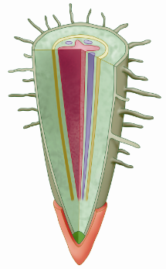

How do plants absorb water and minerals?
2a Water moves across the cortex from cell to cell by osmosis
1 Water moves into the root hair by osmosis
3 Water moves into the xylem vessels and is drawn up by the transpiration pull
soil water
soil particles
2b Water moves along the cell walls of the cortex cells
root hair
epidermis
cortex
xylem vessel

Slide 17
Absorption of minerals by roots
Mineral ions are usually present only at a very low concentration in the soil water.
The root epidermal cells have to absorb the mineral ions against a concentration gradient by active transport.
requires energy
Mineral ions are dissolved in soil water and move into roots along with water.

Slide 18
Absorption of minerals by roots
When the soil water contains higher concentrations of these ions than the root cells, the ions will enter the root cells down a concentration gradient by diffusion.
rarely occurs
Notes:
18

Slide 19

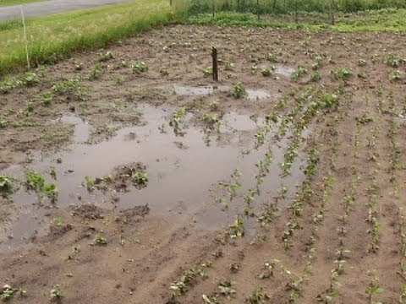
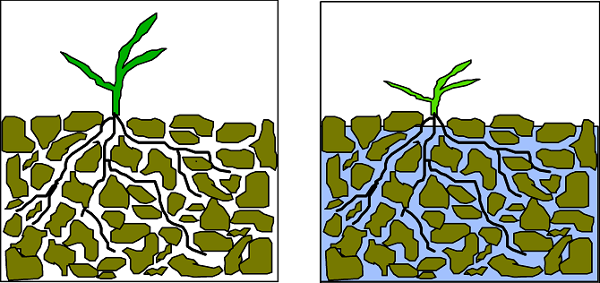
If the soil is flooded with water (becomes waterlogged), how will this affect the absorption of water and minerals of plants?
The soil will become poorly aerated and the plant roots cannot obtain enough oxygen for respiration. The rate of mineral uptake by active transport is lowered and thus fewer minerals are absorbed. As a result, less water is absorbed by osmosis.

Slide 20

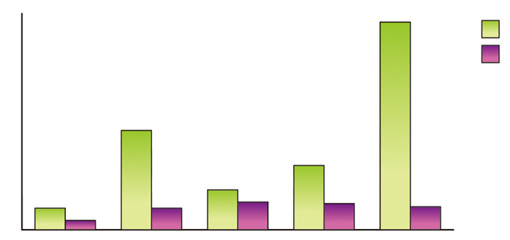
4 Movement of substances across the cell membrane
◆ 4.2 Movement of substances across the cell membrane
Activity 4.2 Handling Data
Absorption of minerals by roots
The graph below shows the concentrations of certain mineral ions in the root cells of a terrestrial plant and outside the plant in the soil water.
Key:
in root cells
ion concentration (arbitrary unit)
in soil water
sodium
potassium
magnesium
calcium
chloride

Slide 21
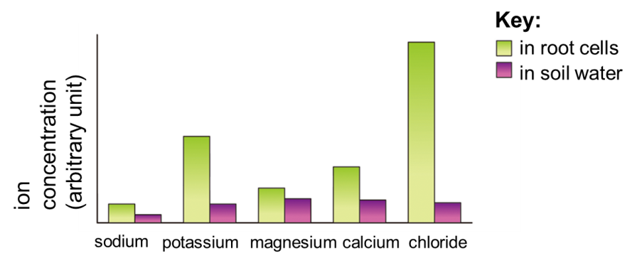
4 Movement of substances across the cell membrane
◆ 4.2 Movement of substances across the cell membrane
Activity 4.2 Handling Data
According to the graph, explain why the plant cannot obtain the above minerals from the soil by diffusion.
Because the mineral concentration in the soil water is lower than that in the root cells, thus the minerals are absorbed against a concentration gradient.

Slide 22
4 Movement of substances across the cell membrane
◆ 4.2 Movement of substances across the cell membrane
Activity 4.2 Handling Data
State a possible mechanism by which the plant can obtain these minerals from the soil.
Active transport.

Slide 23
4 Movement of substances across the cell membrane
◆ 4.2 Movement of substances across the cell membrane
Activity 4.2 Handling Data
Plants grow poorly on waterlogged or poorly aerated soil due to mineral deficiency. Why?
In waterlogged or poorly aerated soil, the root hair cells cannot carry out respiration efficiently to release energy due to shortage of oxygen. As a result, the absorption of minerals by active transport is inhibited.

